Slide 1
Online Shopping Cart
Developed By : Jayesh Ahir

Slide 2
Project Contains
Project Specification
Introduction
SDLC –Spiral Module
Software Requirements
Tools & Technologies
How To Download
How To Run Project
Limitations
Bibliography
Future Enhancements

Slide 3
Project Specifications
Project Title : Online Shopping Cart Front End Tools : Asp.net ,MVC Back End Tool : SQL Server Operating System : Microsoft windows 10 Web Server : IIS Web Browser : chrome Editor : Visual studio 2019 Hardware : 64-bit processor, 1.70 GHz, 4.00 GB RAM

Slide 4
System Development Strategy
As per the requirement of the project, We have choose
the Spiral as a strategy of developing the project, because
in Spiral-SDLC model starts with a small set of requirement
and goes through each development phase for those set of
requirements, so the appropriate strategy is spiral model.

Slide 5
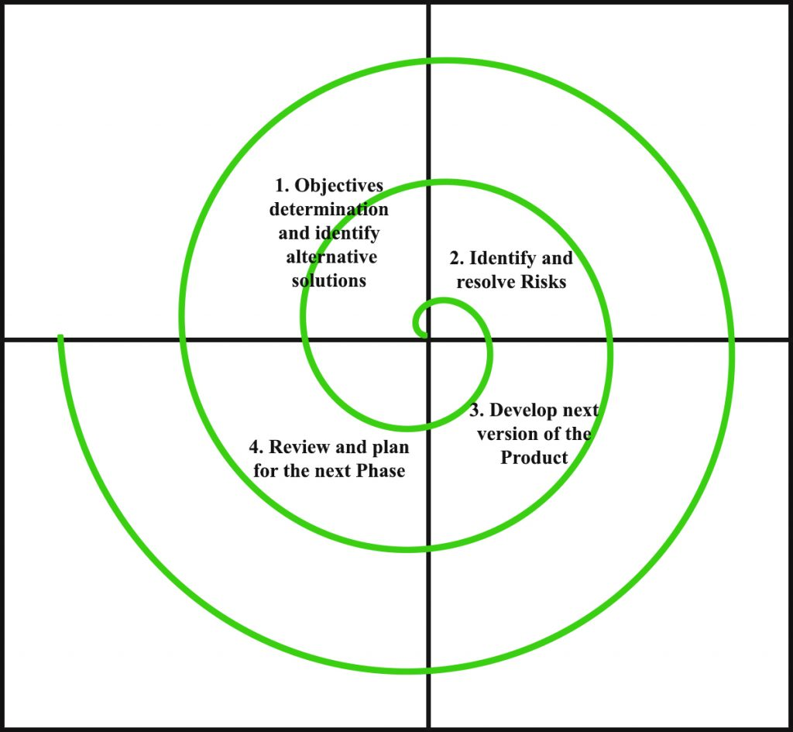
Spiral Module

Slide 6
Data Flow Diagram
A data-flow diagram (DFD) is a graphical representation of the "flow" of data through an information system. DFDs can also be used for the visualization of data processing (structured design).
On a DFD, data items flow from an external data source or an internal data store to an internal data store or an external data sink, via an internal process.

Slide 7
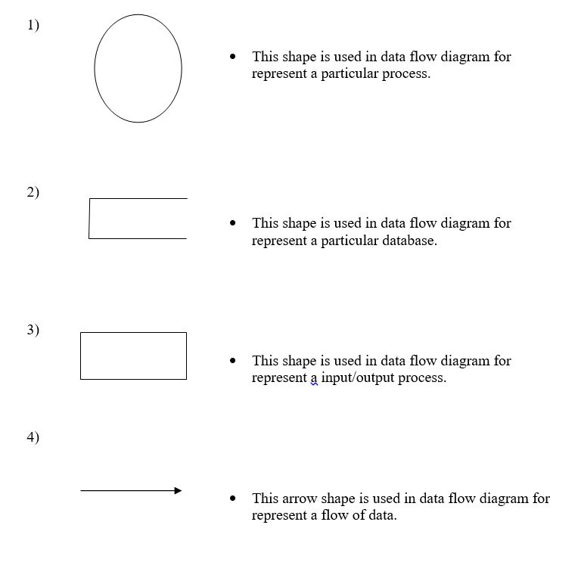

Slide 8
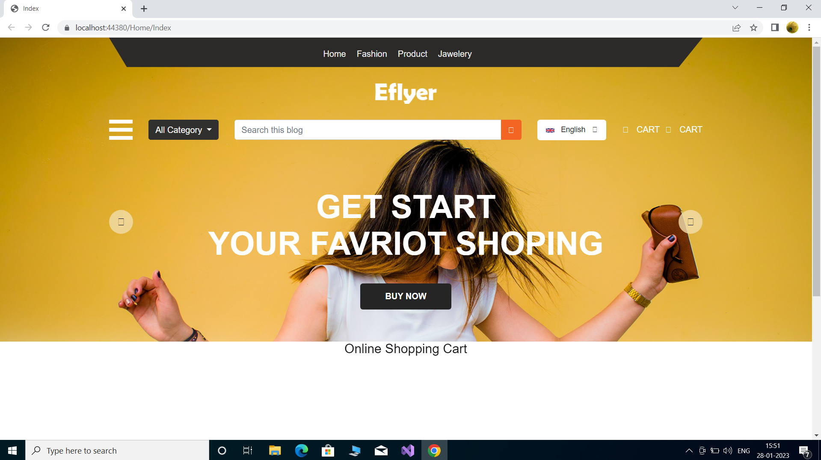
User : Home Header

Slide 9
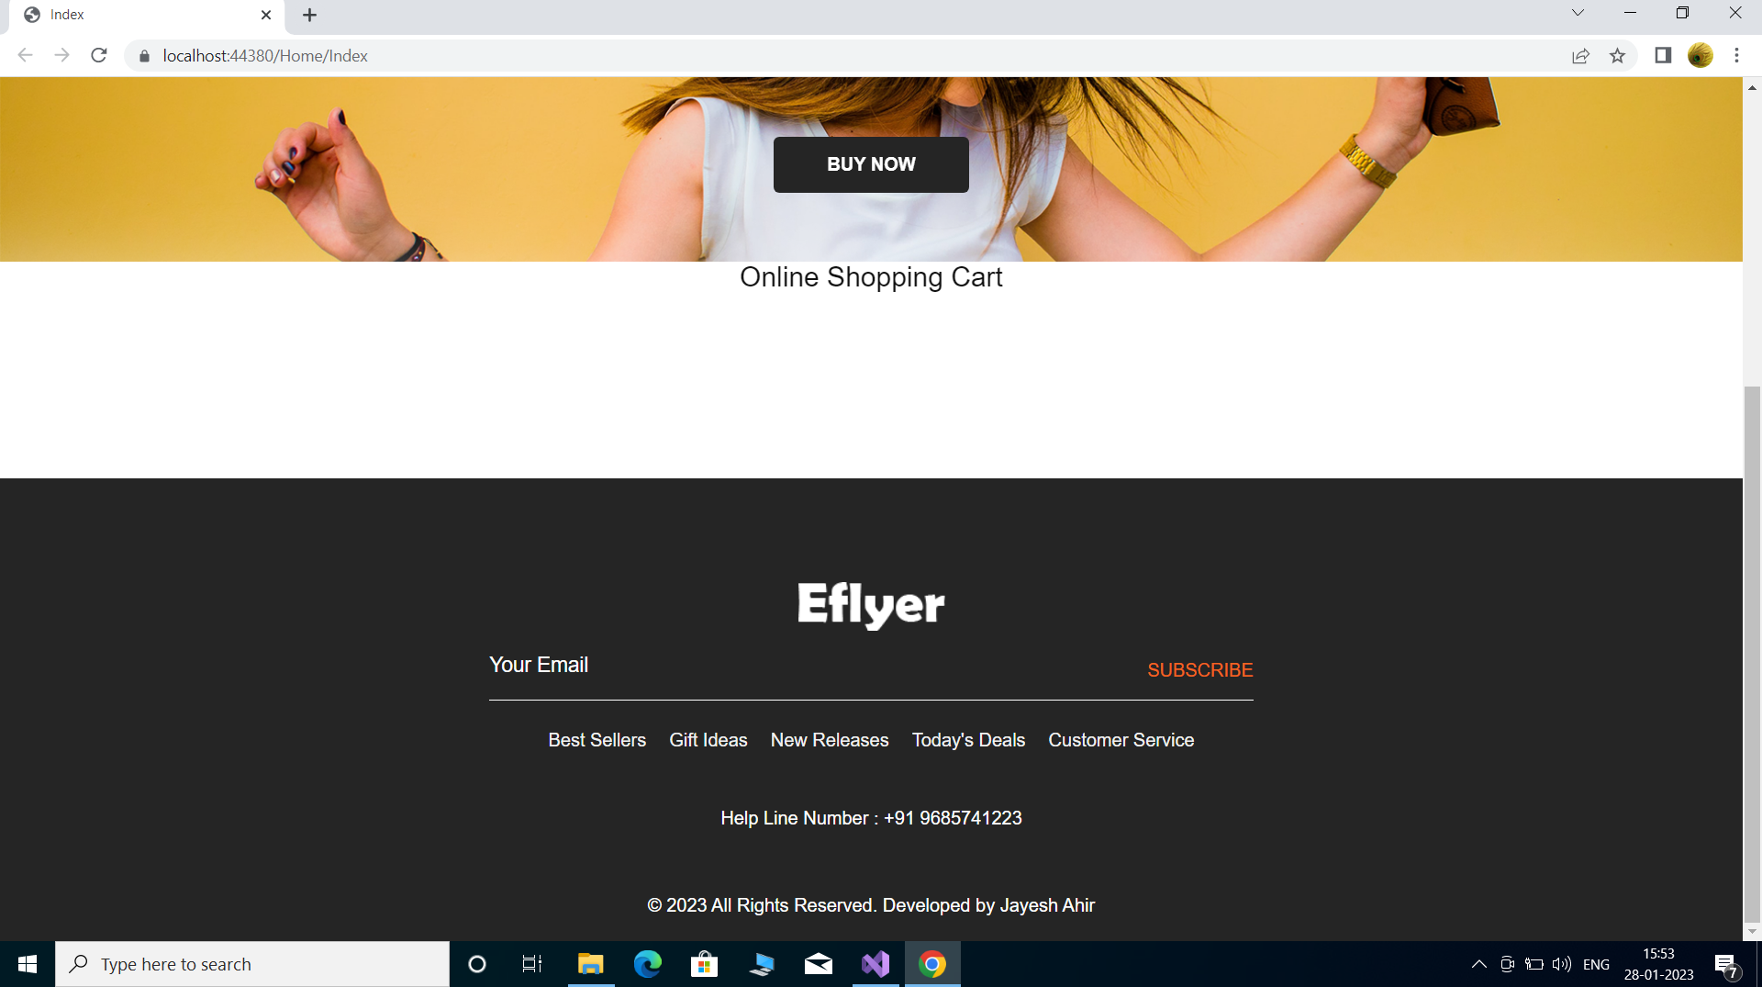
User : Home Footer

Slide 10
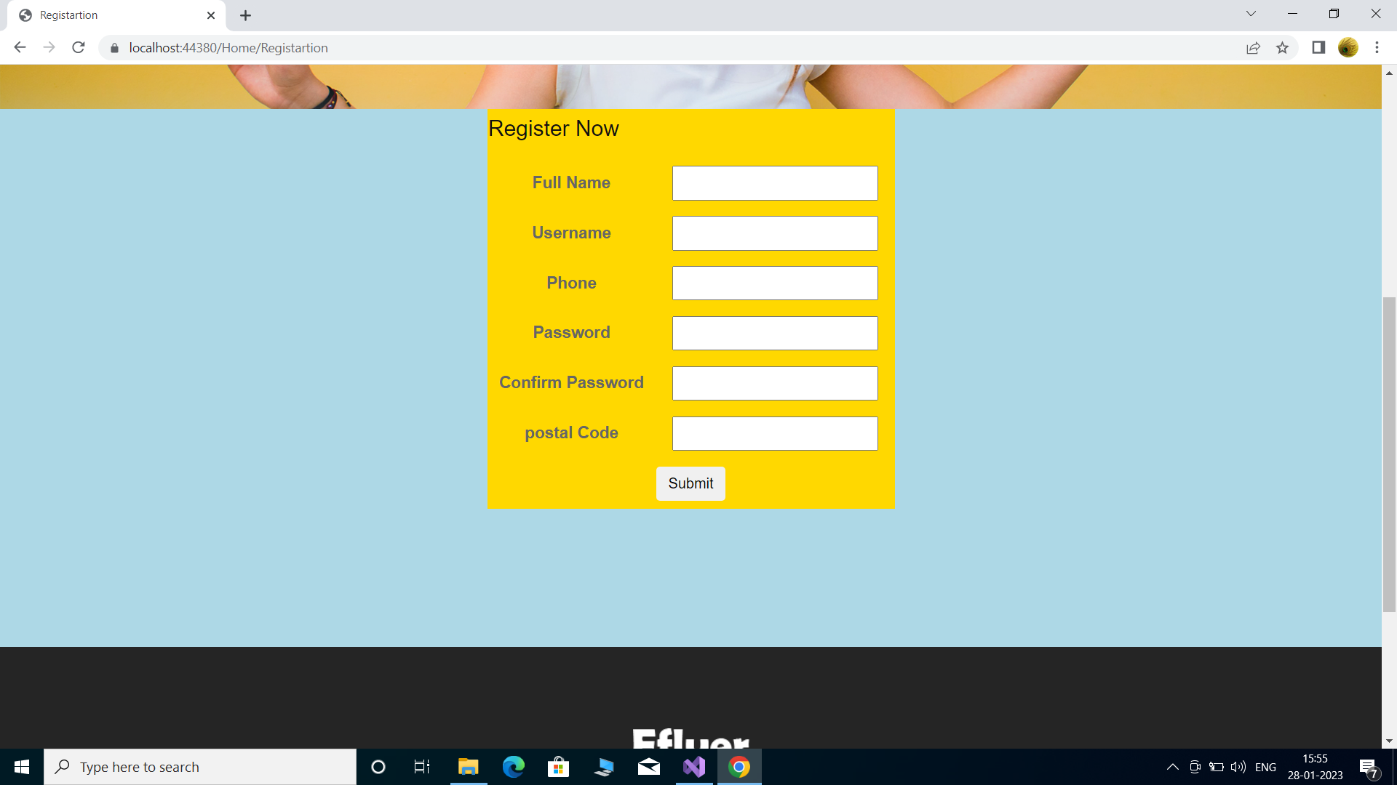
User : About

Slide 11
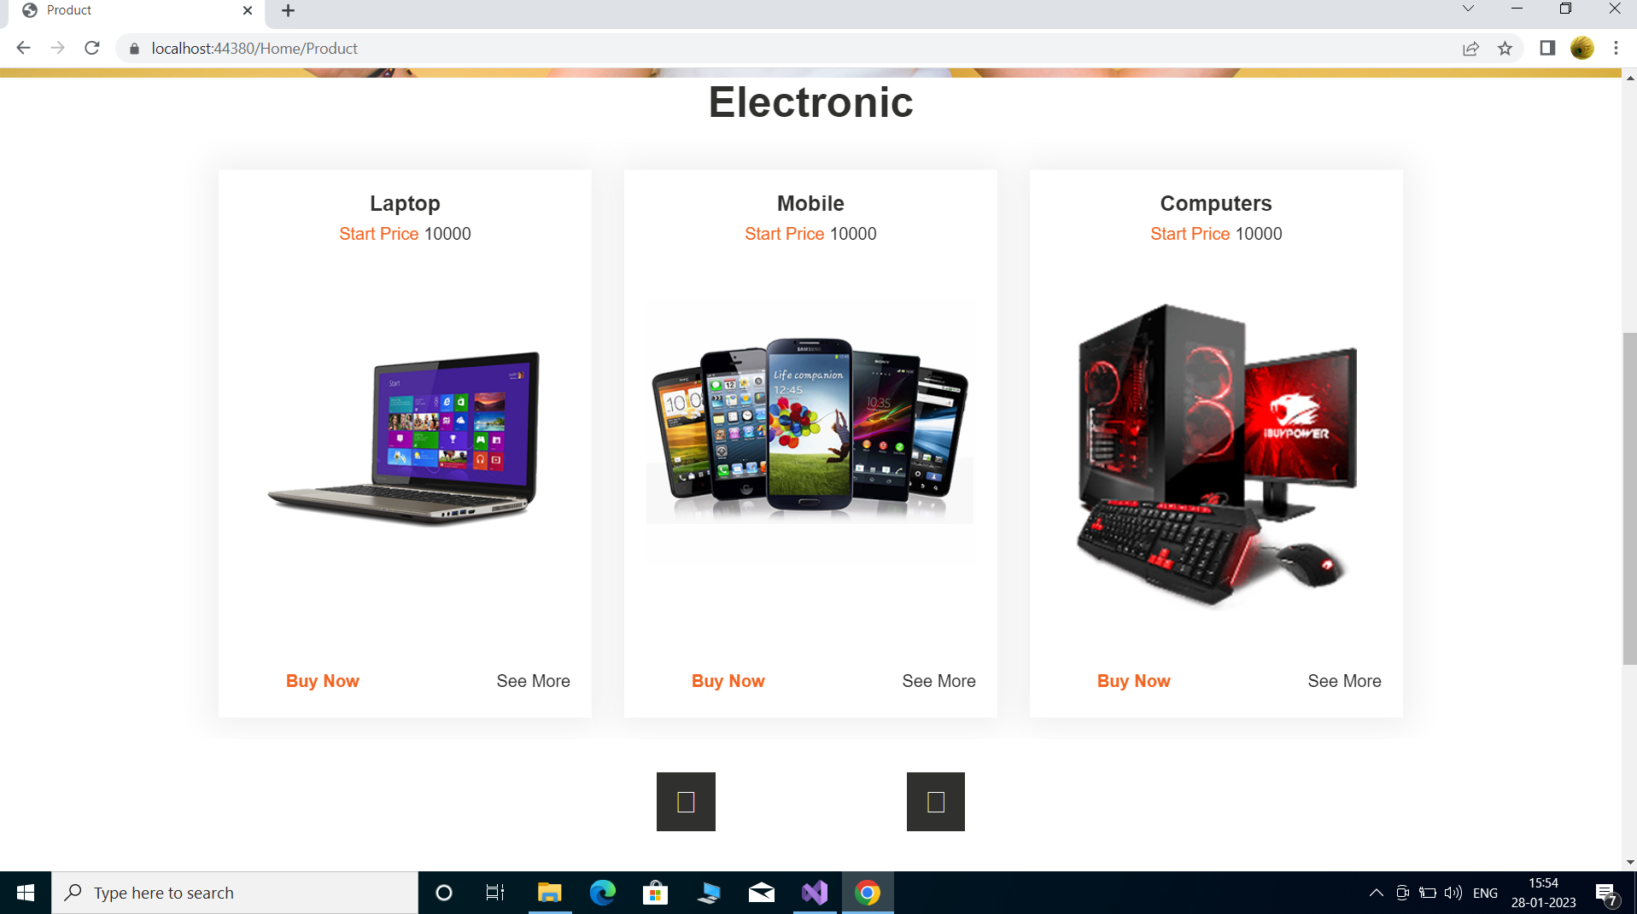
User : Car

Slide 12
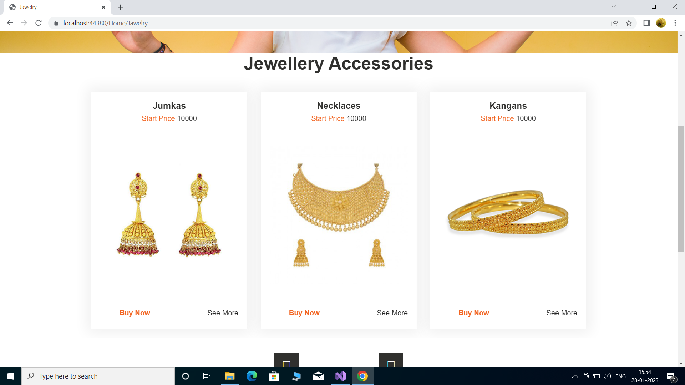
User : Car Info

Slide 13
User : Features

Slide 14
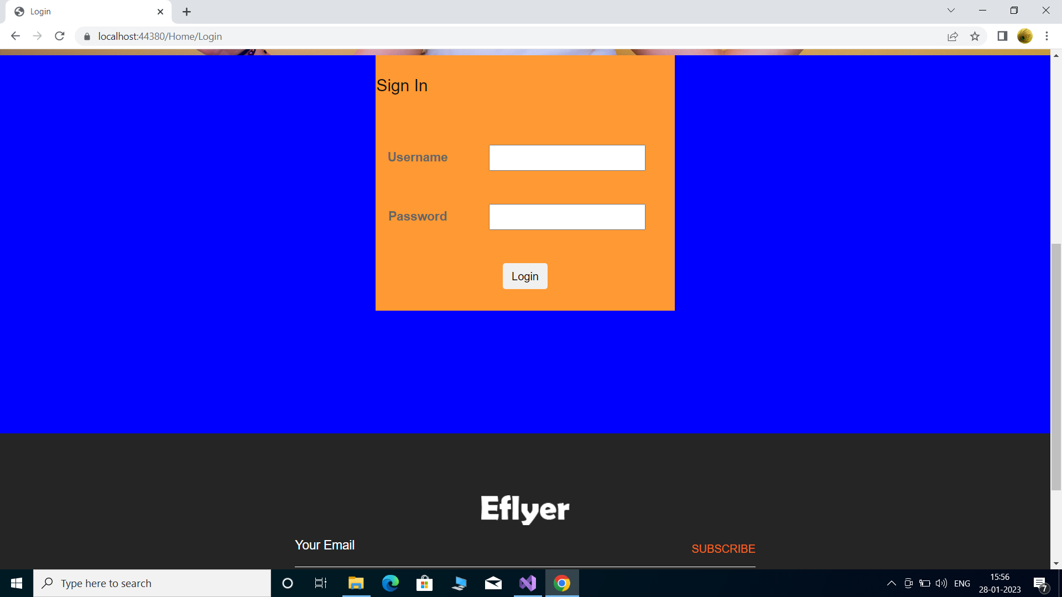
User : Services

Slide 15
Testing and Implementation
Grey Box Testing
Grey Box testing is testing technique performed with limited information about the internal functionality of the system. Grey Box testers have access to the detailed design documents along with information about requirements.
Grey Box tests are generated based on the state-based models, UML Diagrams or architecture diagrams of the target system.
Black Box
White Box
Gray Box

Slide 16
Thank You..!

